Slide 1
KNIGHT’S TRAVAILS
By
Meenasree Ananthavelu
Roja Kamble

Slide 2

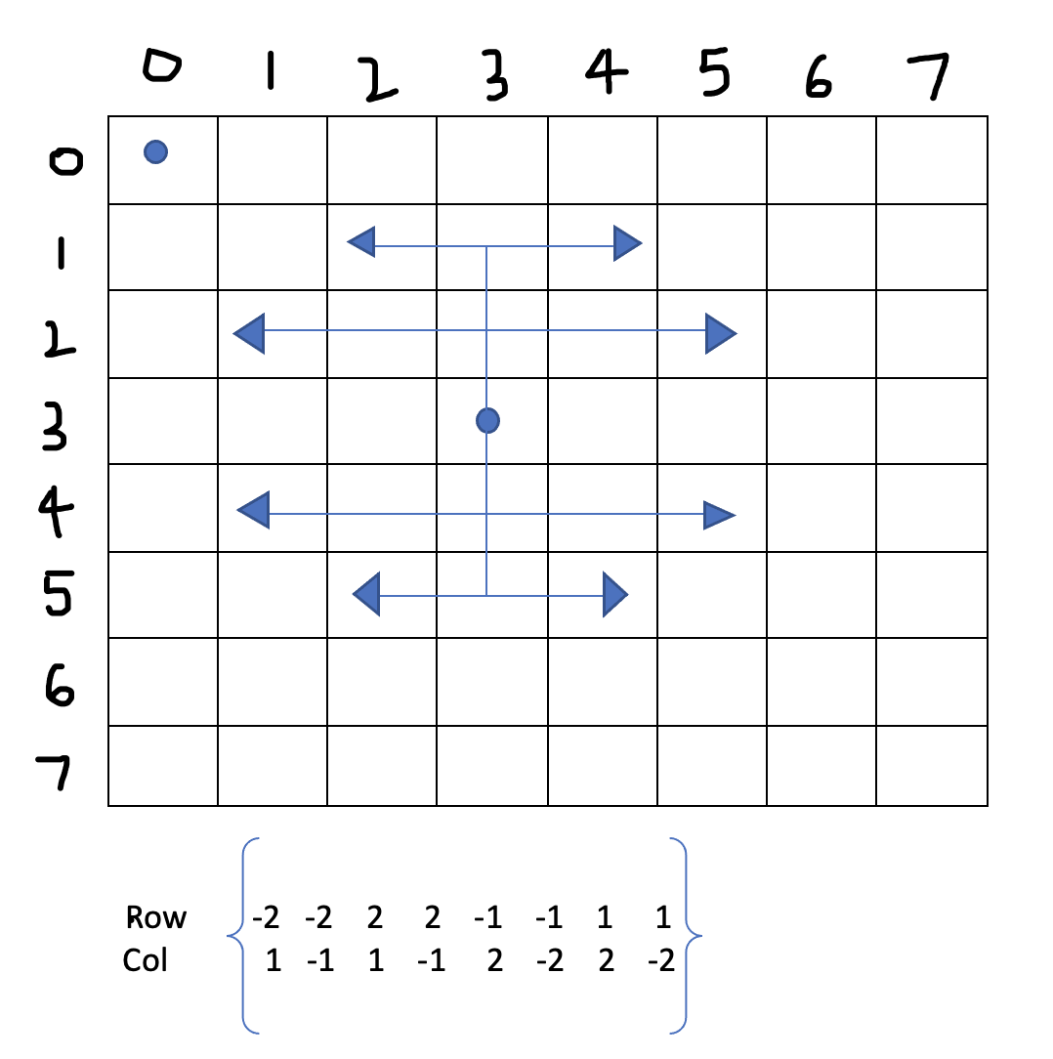
INTRODUCTION
To find a path a knight can travel on a chess board using backtracking algorithm.
To research the knight tour from the corner and middle start positions with boards of different sizes.
CONSTRAINTS:
Knight should not traverse through the same cell twice.
Knight should stay within the boundary of the board.

Slide 3
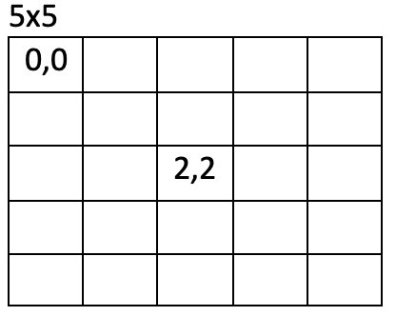
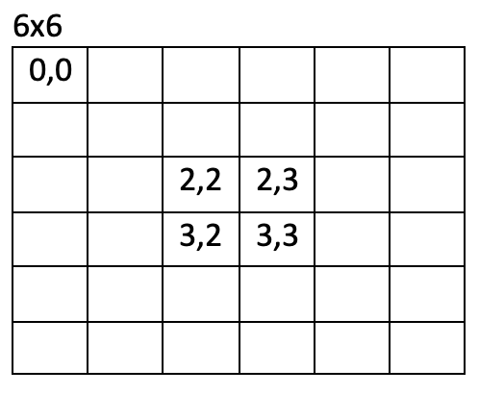
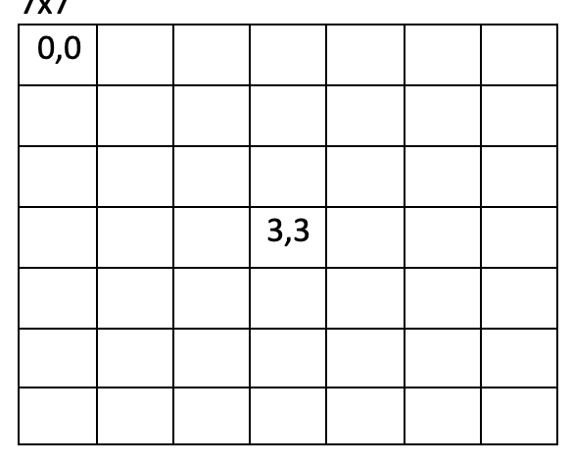
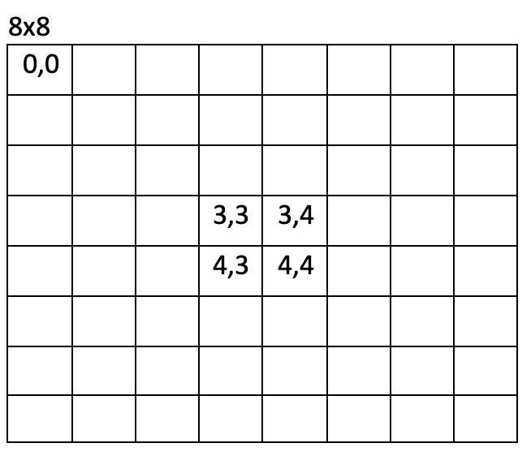
EXPERIMENT
Datasets:
1. The size of the board
2. Start position of the knight.

Slide 4
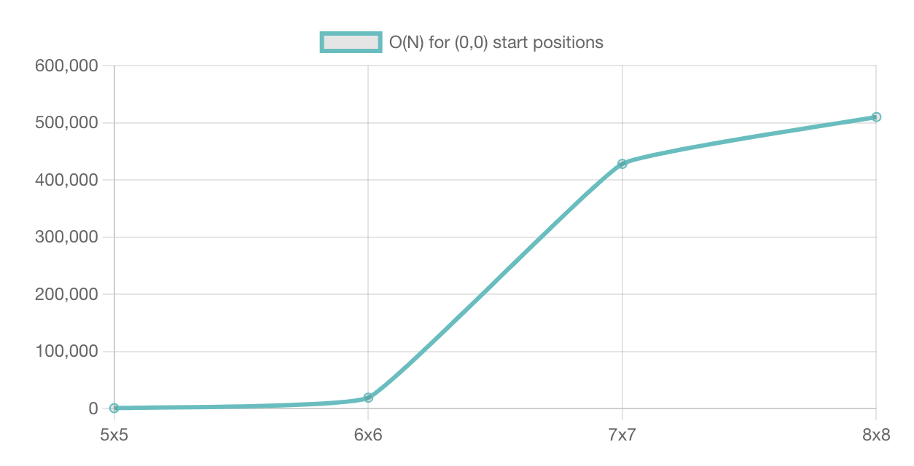
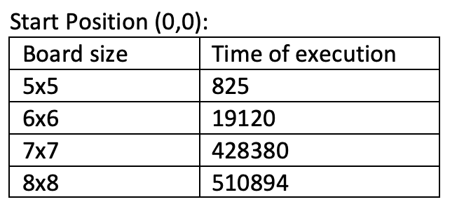
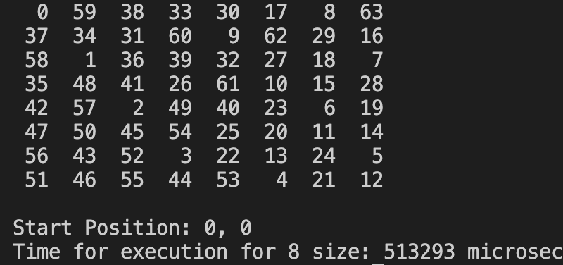
Goal 1
Time Complexity – O(N^2)
Different board sizes from 5x5 to 8x8.
knight’s path from corner start position
Output of Board size - 8x8

Slide 5
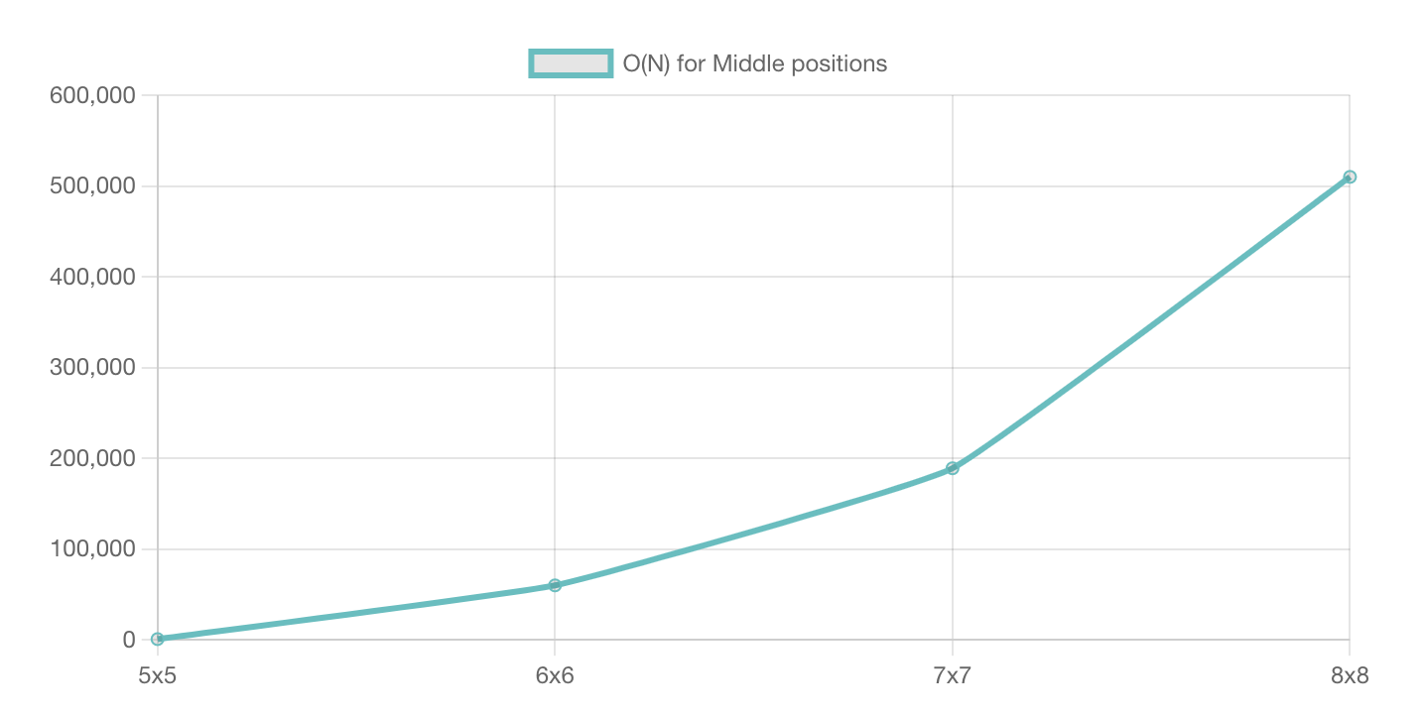
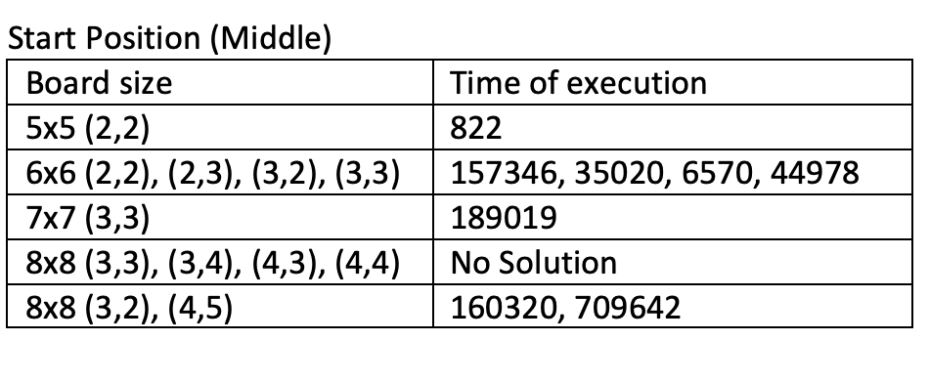
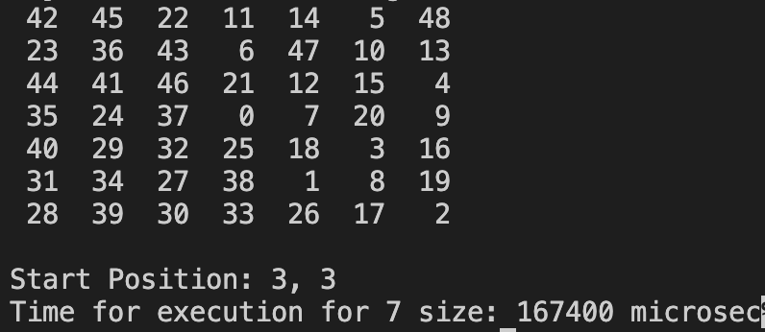
Goal 2
Time Complexity – O(N^2)
By backtracking and to attain closed tour of the knight’s path from middle start position.

Slide 6


